Slide 1

Ways to save water
Dana Lim 2A

Slide 2
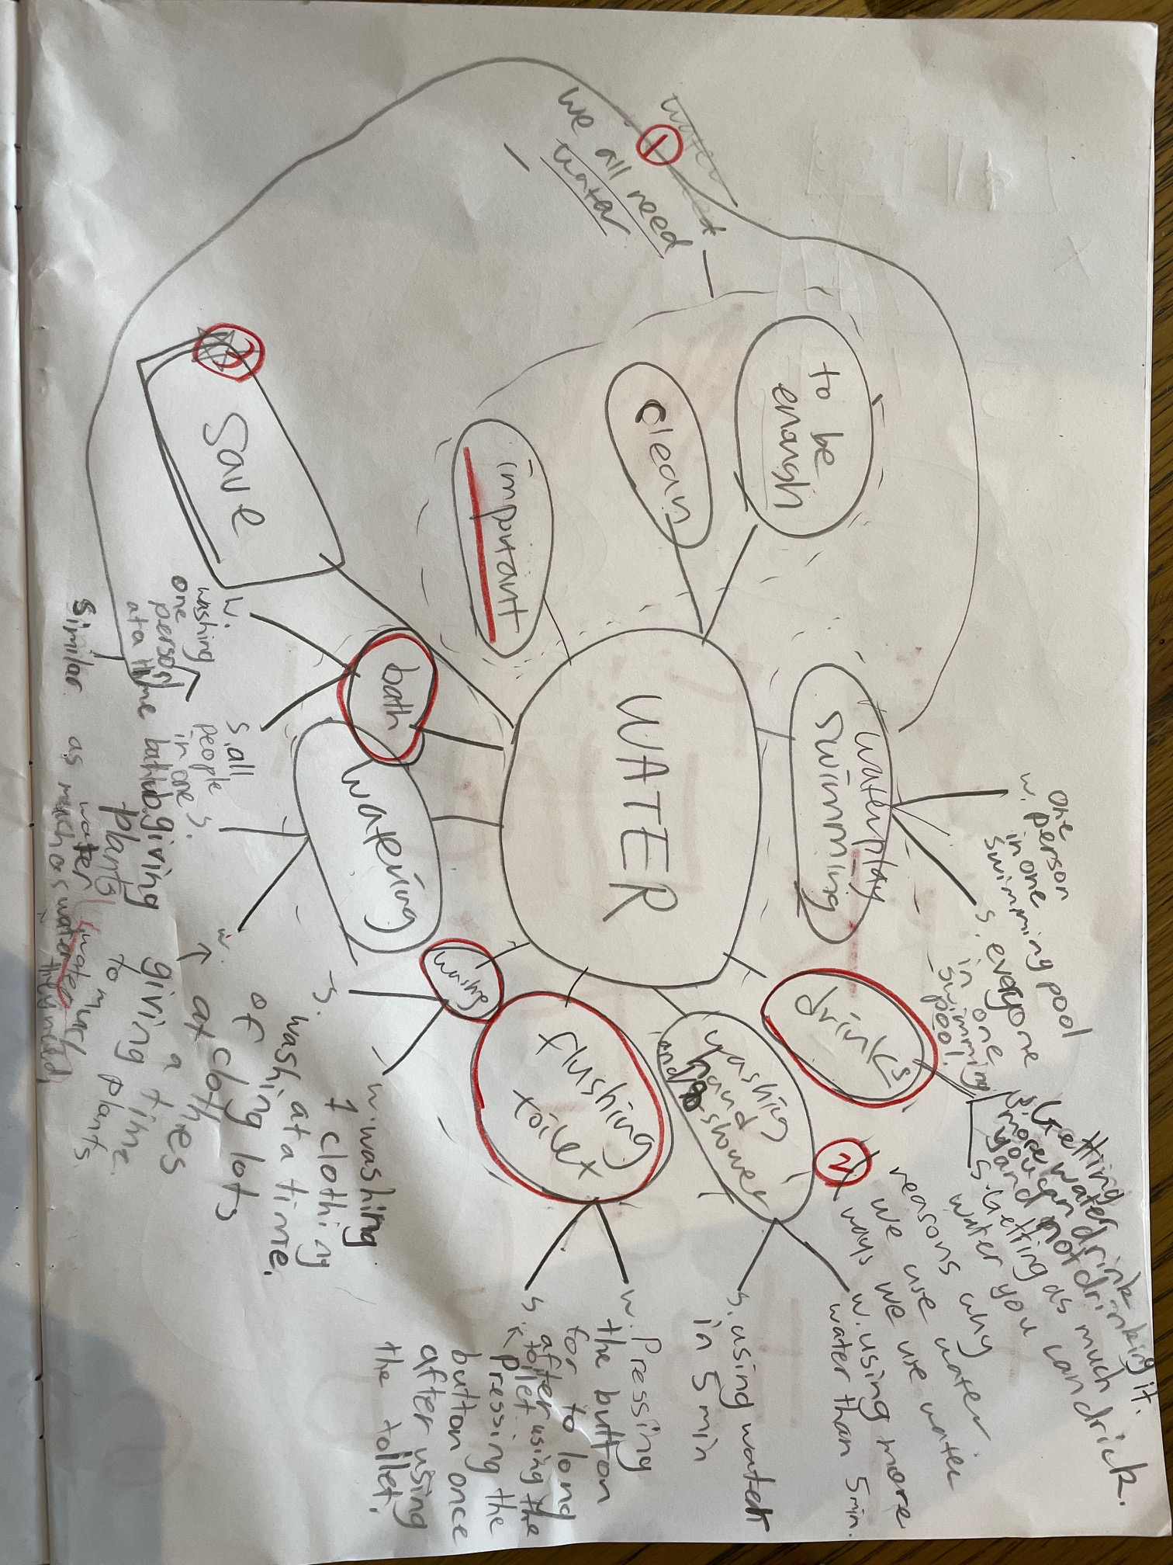
Brainstorming
About Water

Slide 3

Why water is important?

Slide 4
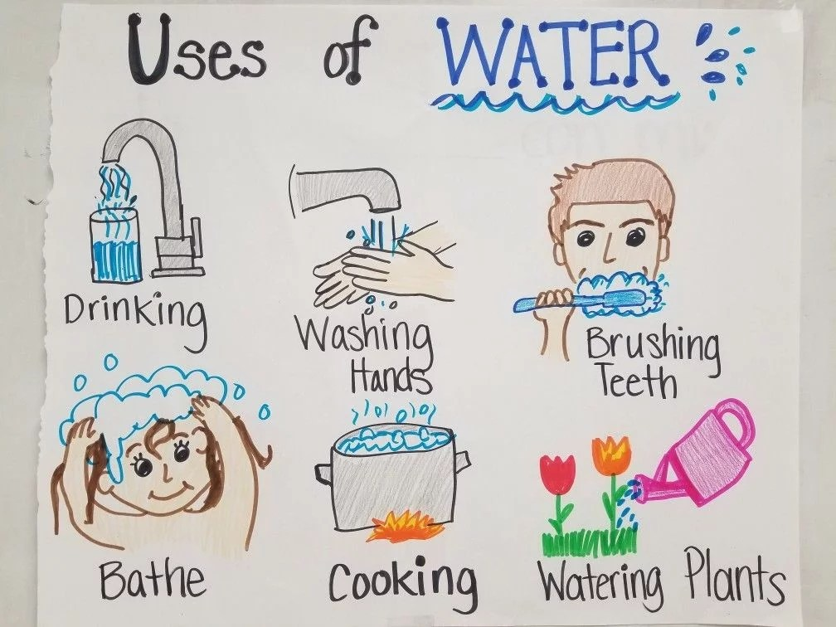

Slide 5
Water In the world

Slide 6
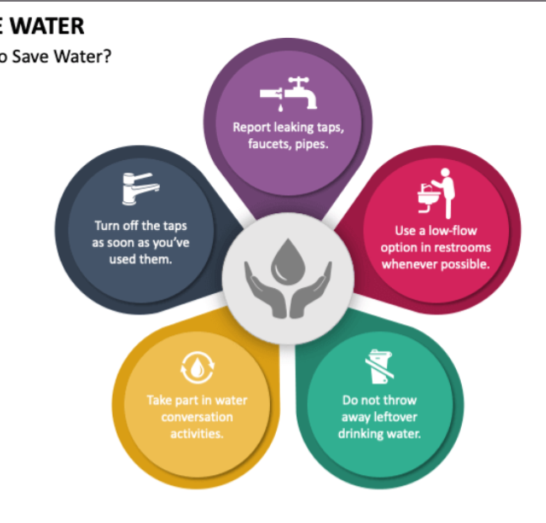
How to save water?
conservation

Slide 7
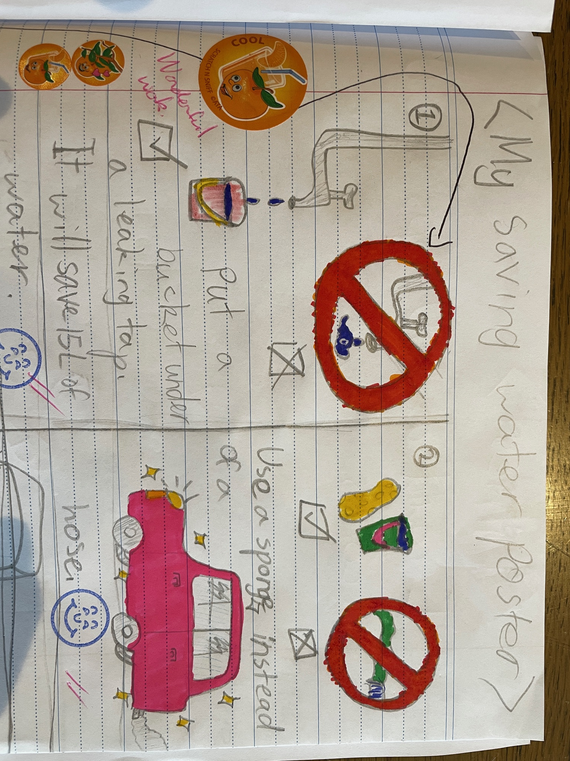

Slide 8
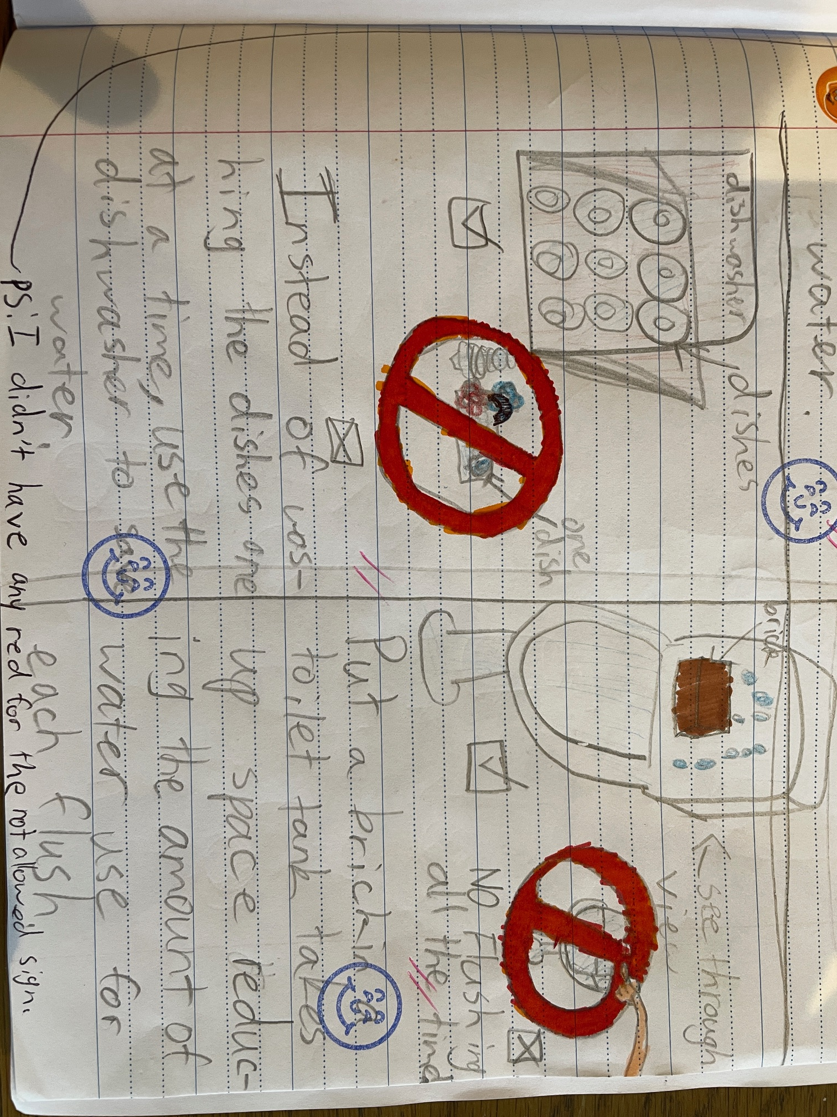

Slide 9
Thanks for listening
2A

