Slide 1

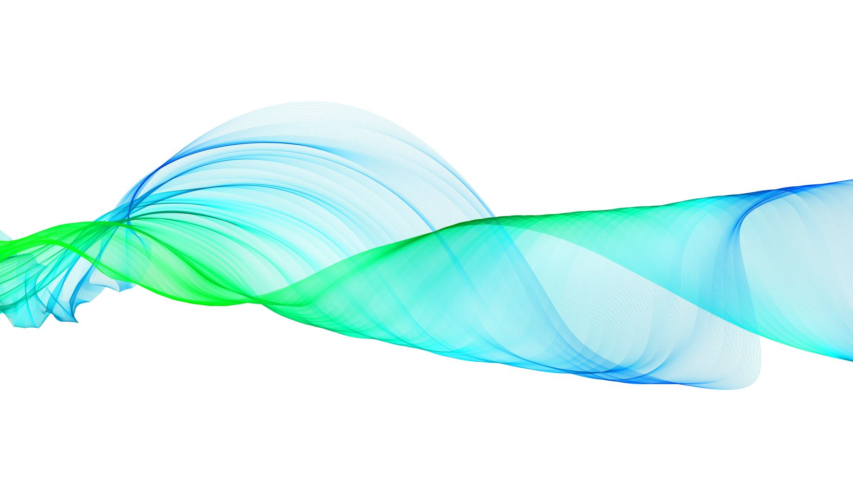
Little Things
2A Dana Lim
Little drops of water, Little grains of sand, Make the mighty ocean And the pleasant land.
So the little errors Lead the soul away From the paths of virtue Far in sin to stray.
So the little moments, Humble though they be, Make the mighty ages Of Eternity.
Little deeds of kindness, Little words of love, Help to make earth happy Like the Heaven above.

